Slide 1
Characteristics of High Gradient Streams
Earth and Space Science
Earthcomm page U-77-7

Slide 2
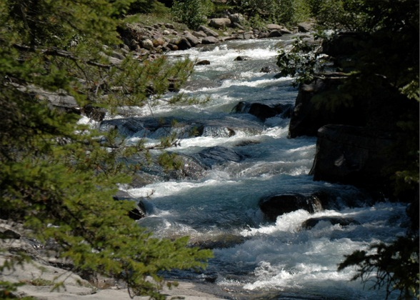
Waterway Definitions
Stream – small or large flow of water in natural channels
River – large flow of water in a natural channel
Brook / Creek - terms used for a small stream

Slide 3
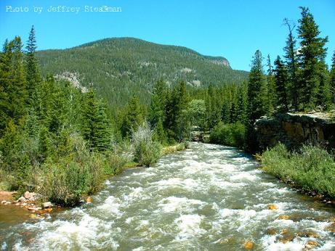
Gradient
The slope of a stream, GRADIENT, is described as the change (loss) of elevation of the stream with distance downstream.
→ higher gradient = steeper

Slide 4
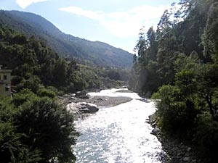
Areas of the stream that are farthest from the mouth and at the highest elevation of the river system are called the HEADWATERS.
→ usually high gradient
→ slope of land usually the steepest here

Slide 5
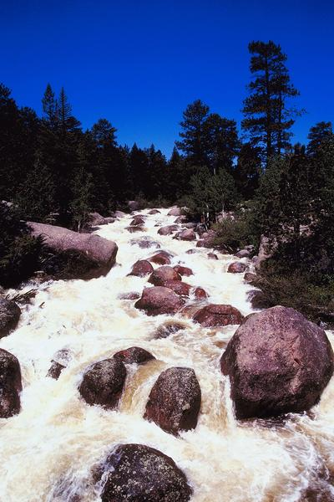
Velocity of the Current
High gradient streams generally have high flow velocities (>3 m/s or > 10 ft/s) in headwaters, the stream is shallow and does not have much water volume yet

Slide 6
High gradient and fast velocity are capable of moving large particles, such as boulders, across the streambed

Slide 7
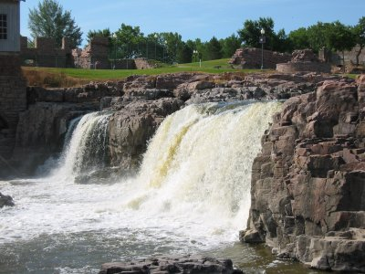
Especially during a flood
Exert large forces on streambed
→ Erode rapidly

Slide 8
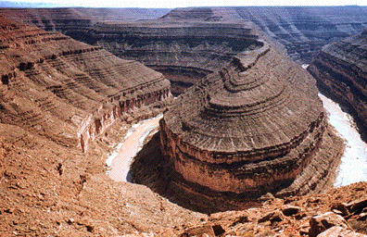
Downcutting – erosion of a valley by a stream
can cut straight down → canyon - steep walls
- valley → “V” shaped with steep sides

Slide 9
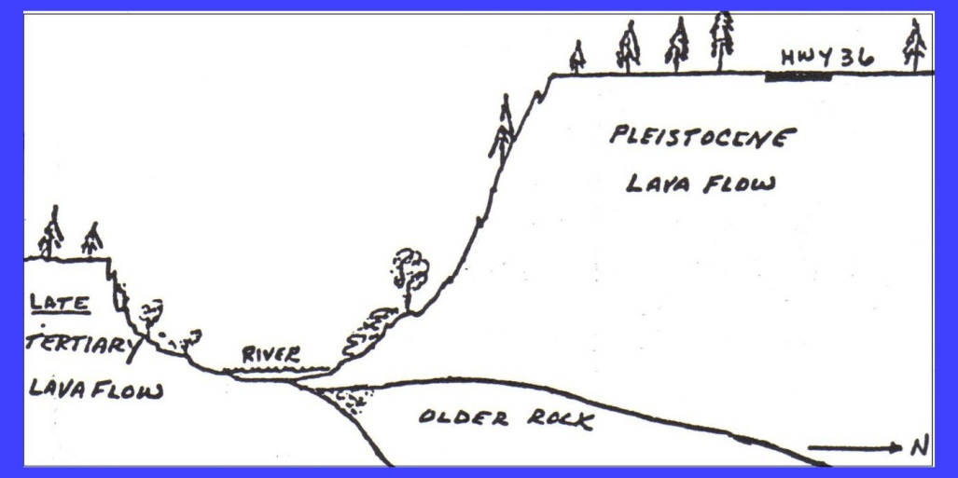
Valley slopes contain materials loosened by weathering and swept into the stream rain and carried away

Slide 10
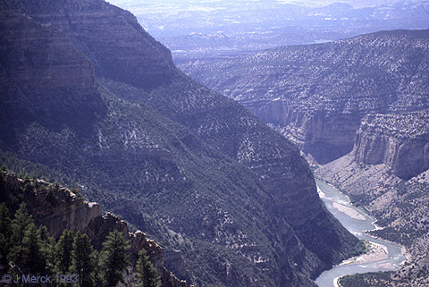
Downcutting occurs too rapidly for valleys to widen out
→ NO floodplain can form

Slide 11
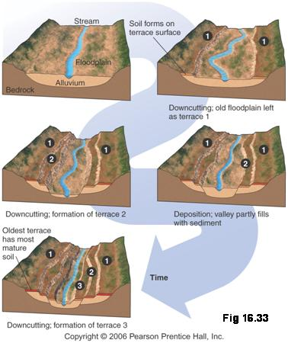
Floodplain – area of a river valley next to the channel, made of deposited sediments and covered with water when floods occur
→ valley sides come very close to the river bank

Slide 12
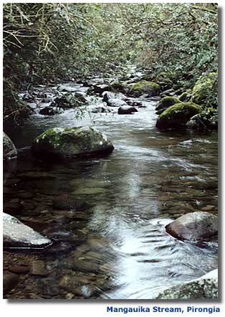
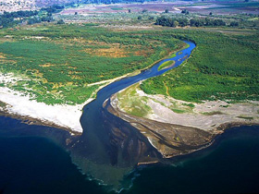
High gradient streams have low stream discharge
volume of water passing a point along the river in a given amount of time

Slide 13
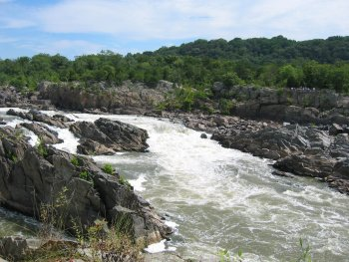
Discharge =
( Cross section of stream channel ) X
( Velocity of water )
Measured in
cubic feet per
second ( ft³/s )
or cubic meters
per second
( m³/s )

Slide 14
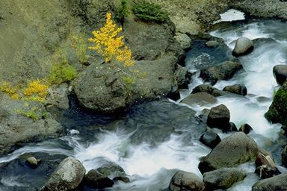
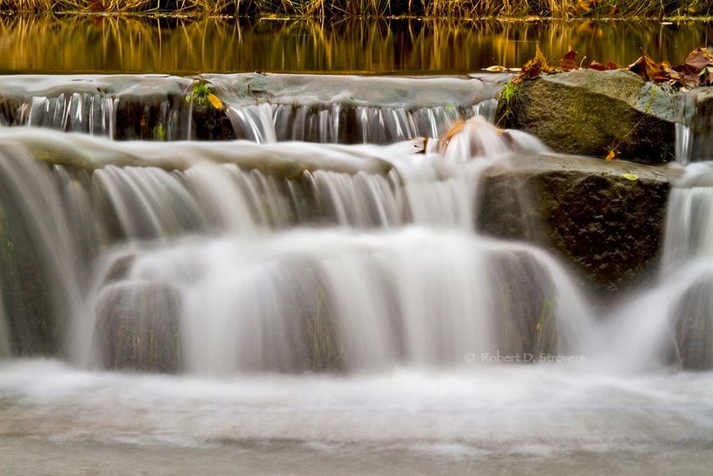
Velocity and discharge of a stream vary over time and depending on environmental conditions:
→ Dry conditions = smaller discharge
→ Wet conditions = increased discharge
(increased rain or snowfall)

Slide 15
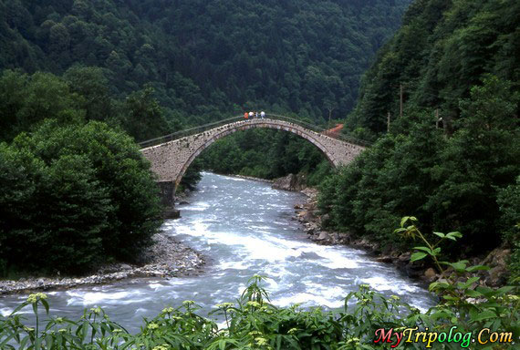
Can be a seasonal cycle (due to weather) of increasing and decreasing discharge
→ flooding

Slide 16
Homework →
1. Read U-77-79
2. Page 79 #1-5

